Slide 1
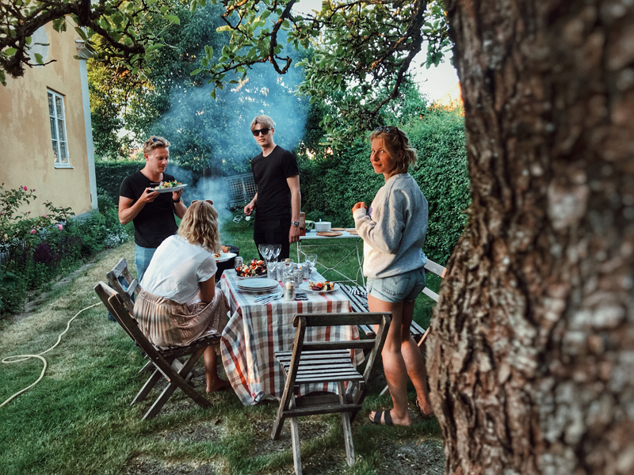
This week I experienced God…

Slide 2
Hearing the joy and laughter as the kids were learning about the life cycle of a butterfly and doing a butterfly craft and a St. Patrick’s Day craft!

Slide 3
Time with family celebrating a birthday.
Loud laughter and smiles.

Slide 5
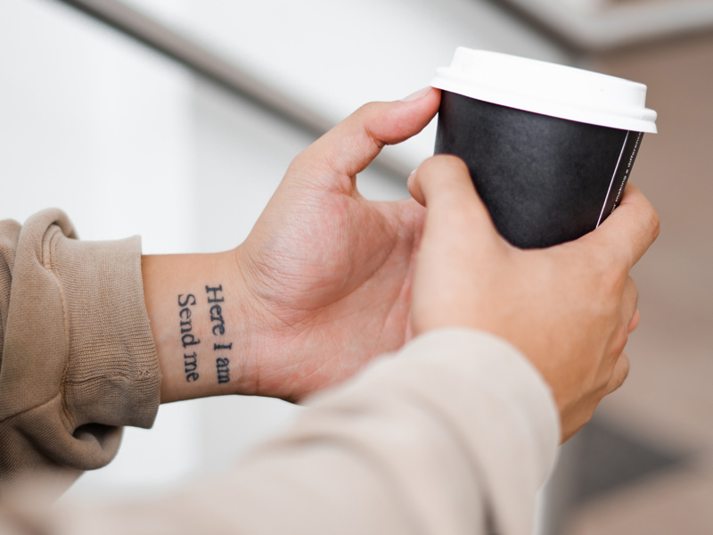
My daughter preparing and performing multiple Irish jigs to Irish music.

Slide 6
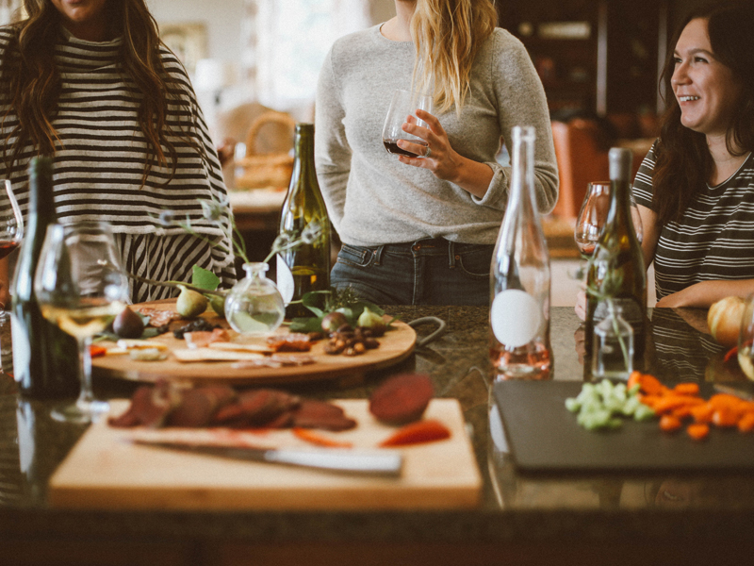
Friends and family talking about the current situation and offering loving support.

Slide 7
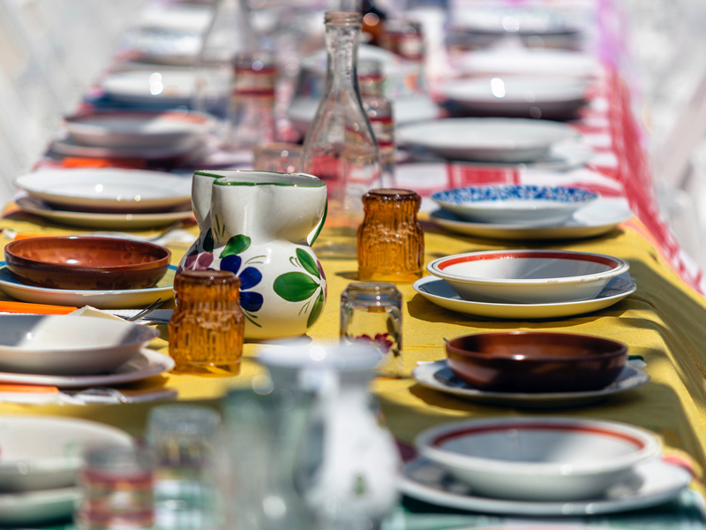
Worship happened, thank you God for Pastor Mary and her flexibility.

Slide 8
Praying the Lord’s Prayer while I pet my dog during our virtual worship service.

Slide 9
God placing names on my heart of people to continue to check in with during our social distancing.
Answering that call and having people feel the love because of it. ♥

Slide 10
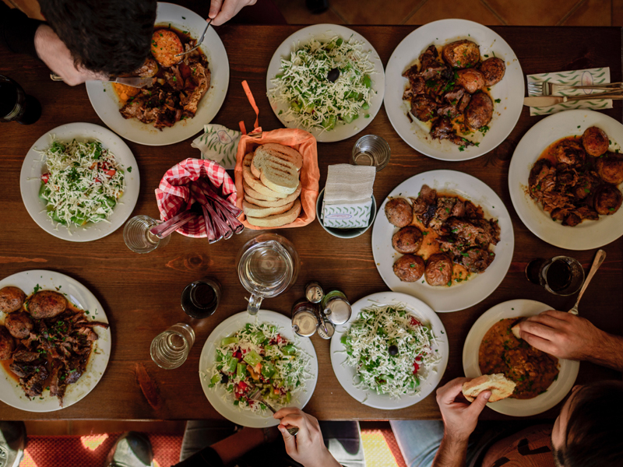
Seeing the smiles on
the families’ faces when
I delivered their meals
from school.

Slide 11
A long awaited night out with the ladies was able to happen before everything shut down.

Slide 12
Neighbors checking in
and helping each other.

Slide 13
Being able to get out in the warm sunshine to do yard work – a welcome respite from a chaotic work week.

Slide 14
A friend checking in at just the right moment and helping me through a crisis.

Slide 15
The blessing of Pastor Mary and her determination to make live streaming of worship take place.
#Blessed by Pastor Mary

Slide 16
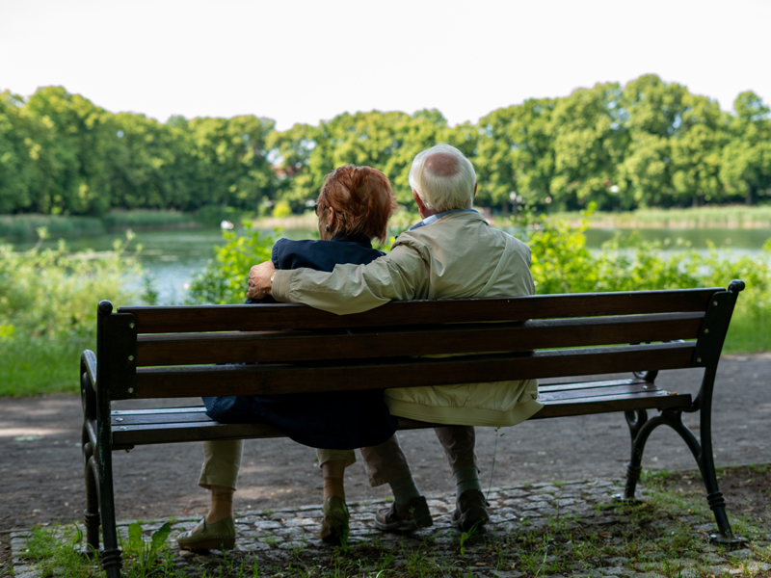
A chance encounter with a woman who was reminiscing about a cruise with her husband and the opportunity to share information about our GriefShare program with her.

Slide 17
Amen.

