Slide 1
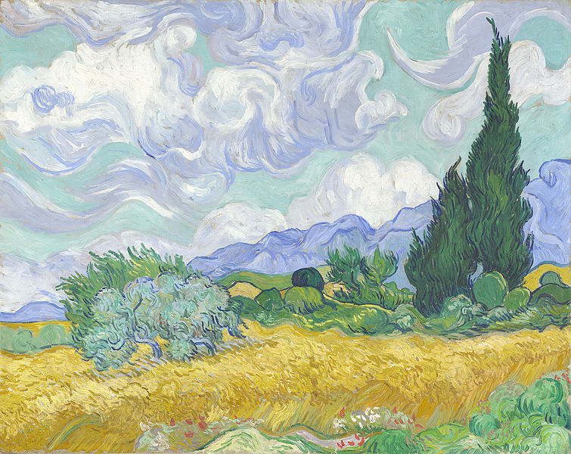

Slide 2
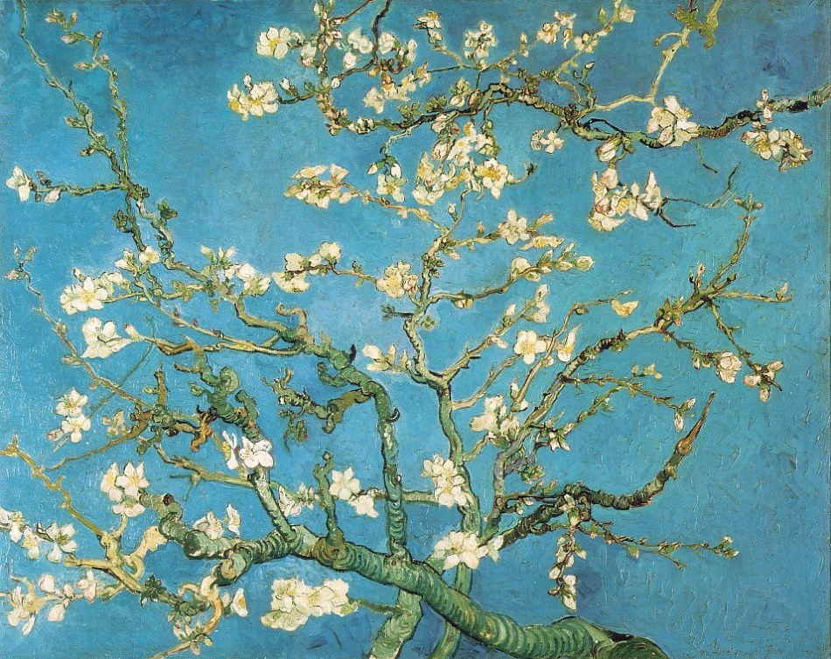
In our doubts,
there is believing.
Natalie Sleeth
“Hymn of Promise”

Slide 3
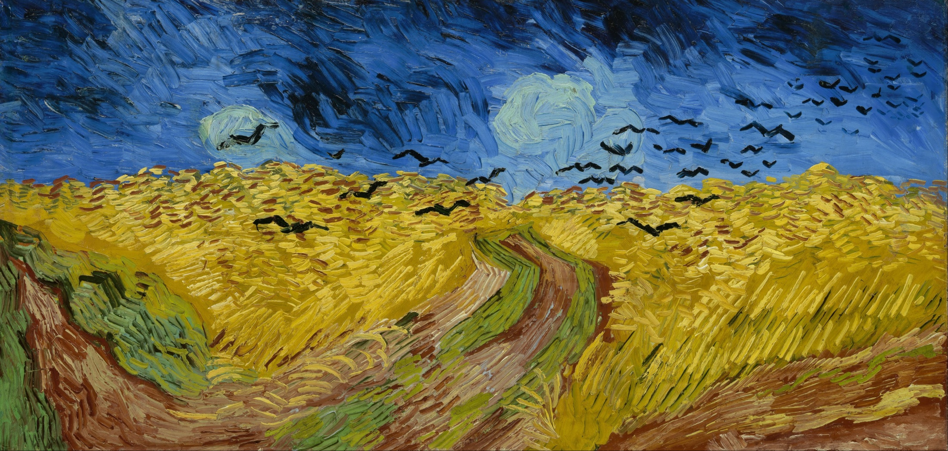

Slide 4
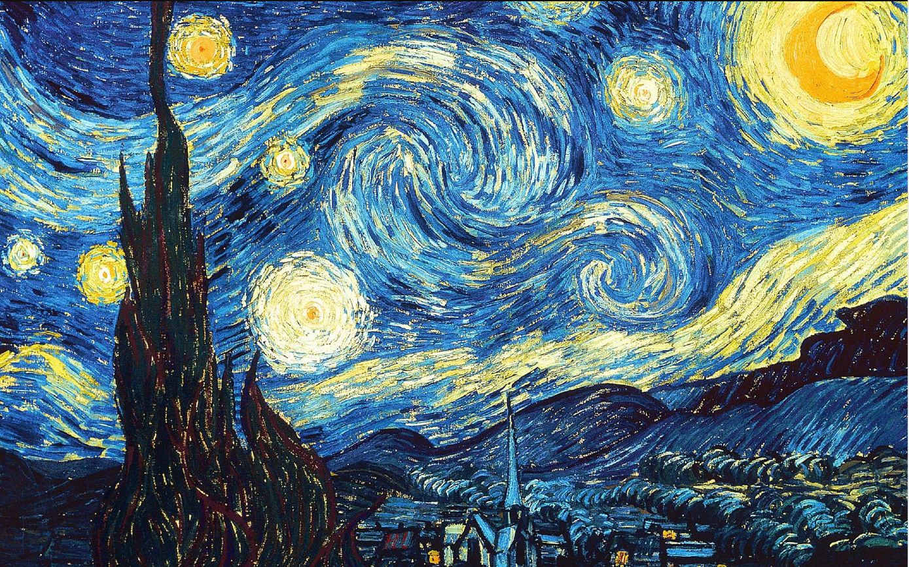
Faith and doubts aren’t opposites.

Slide 5
Doubt is often a sign that your faith has a pulse, that it’s alive and well and exploring and searching.

Slide 6
Faith and doubt aren’t opposites, they are, it turns out, excellent dance partners.
Rob Bell

Slide 7
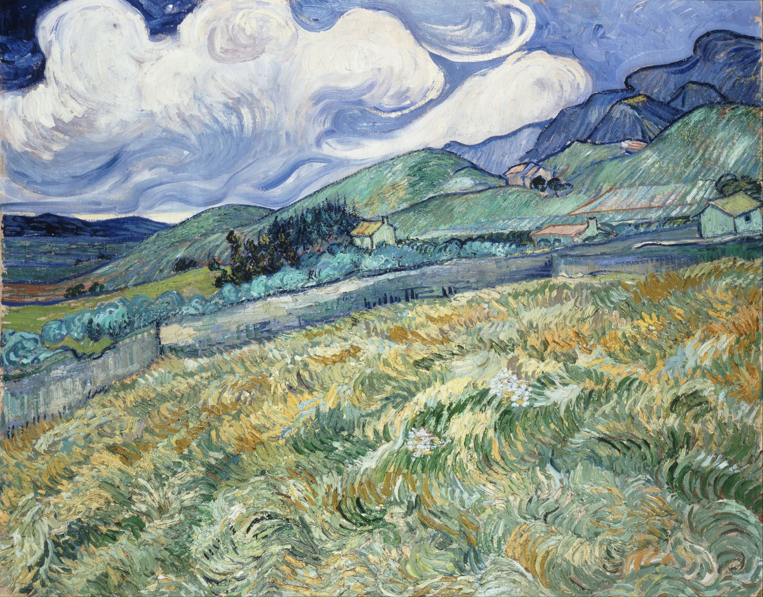

Slide 8
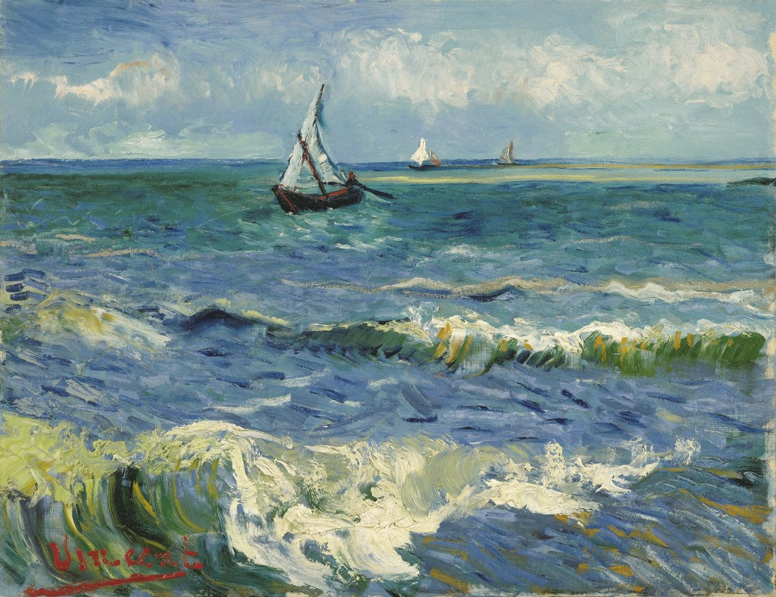
Don’t stay in the boat when God is calling you to walk on water.

Slide 9
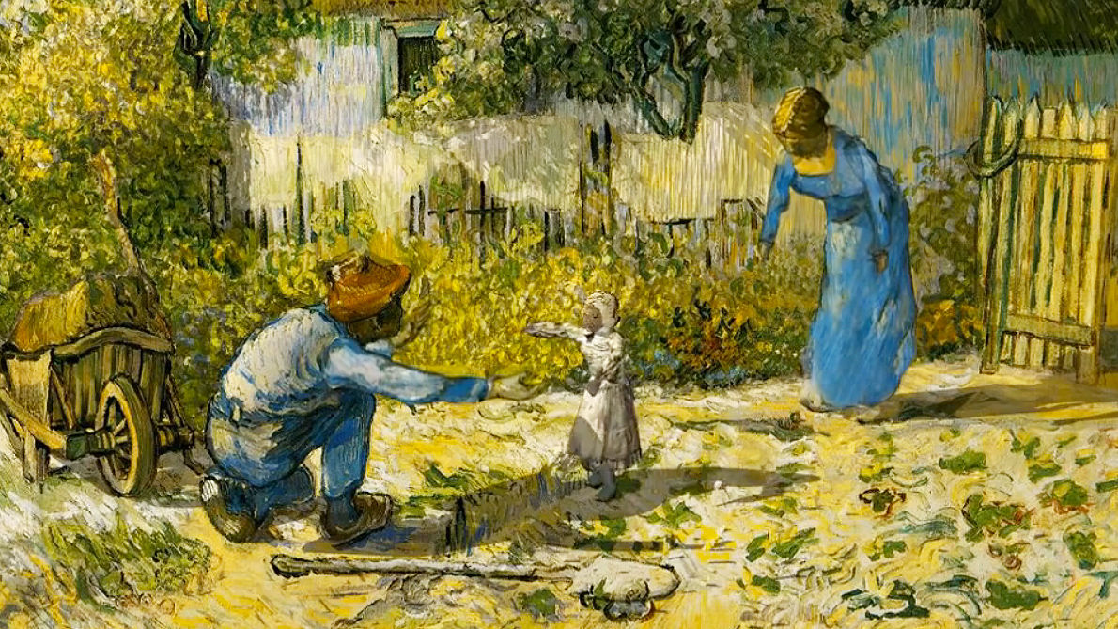

Slide 10
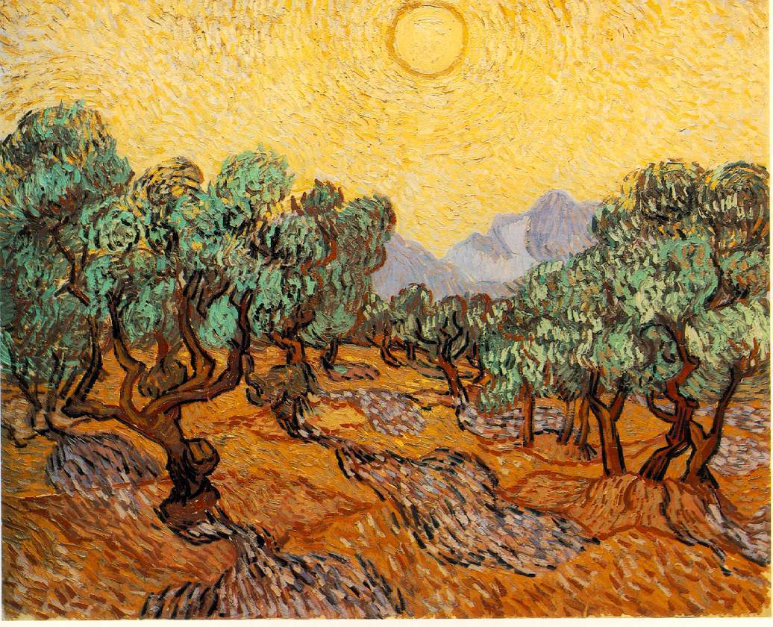
Doubts are the ants in the pants of faith. They keep it moving.
Fred Buechner

Slide 11
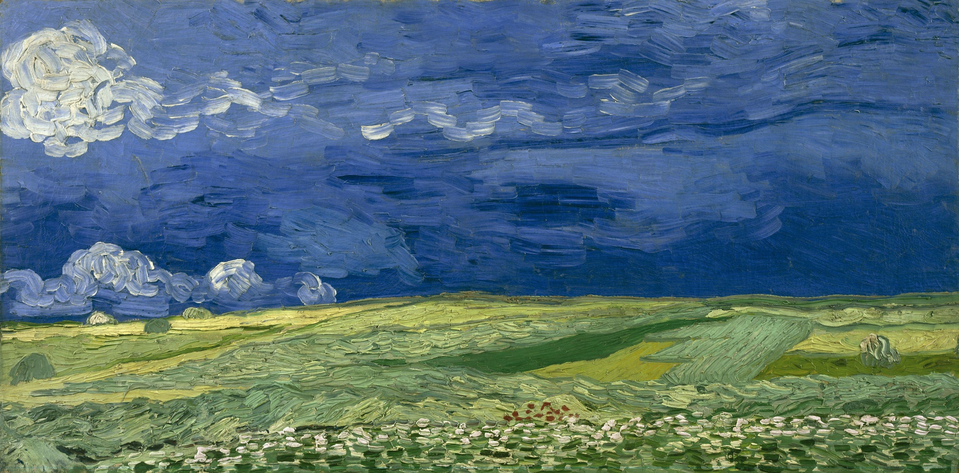

Slide 12
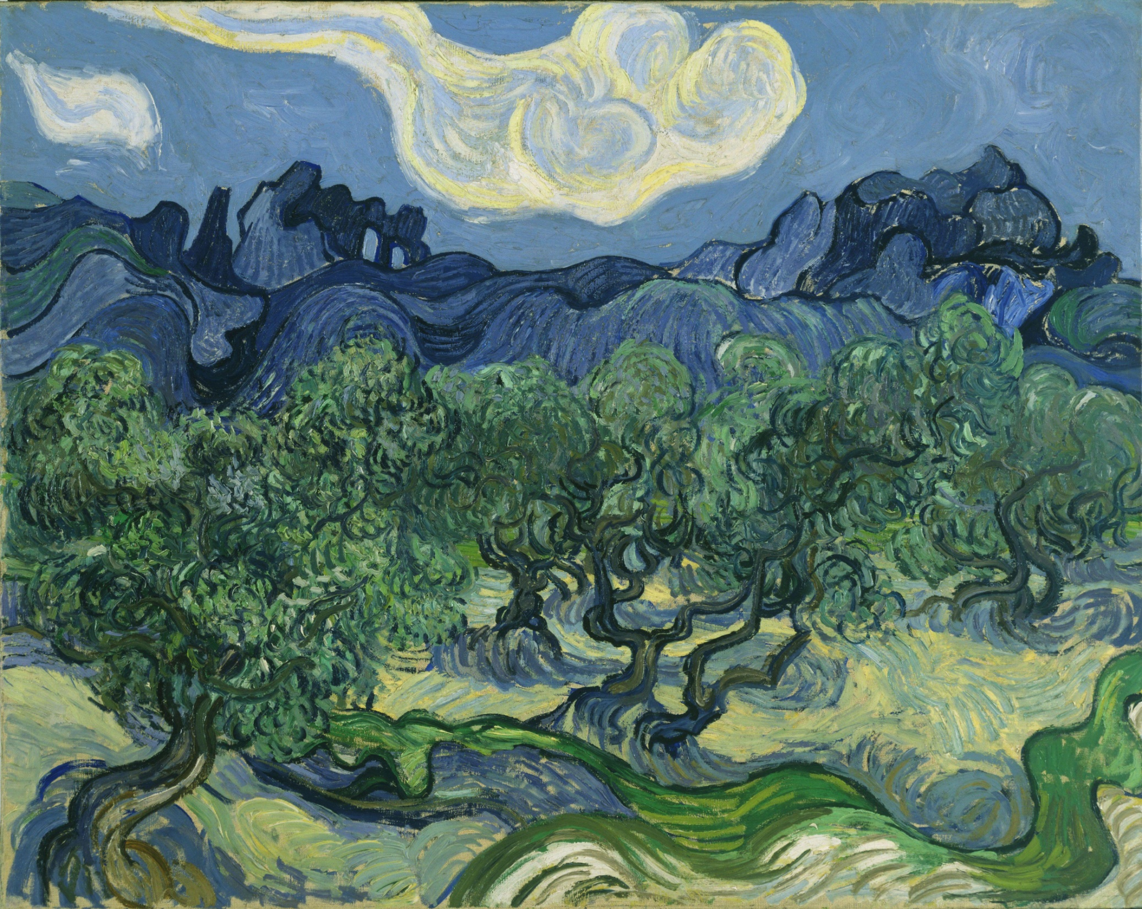
If God is powerful enough to take you to heaven, He’s powerful enough to have your back on earth.
Tony Evans

Slide 13
